Slide 1
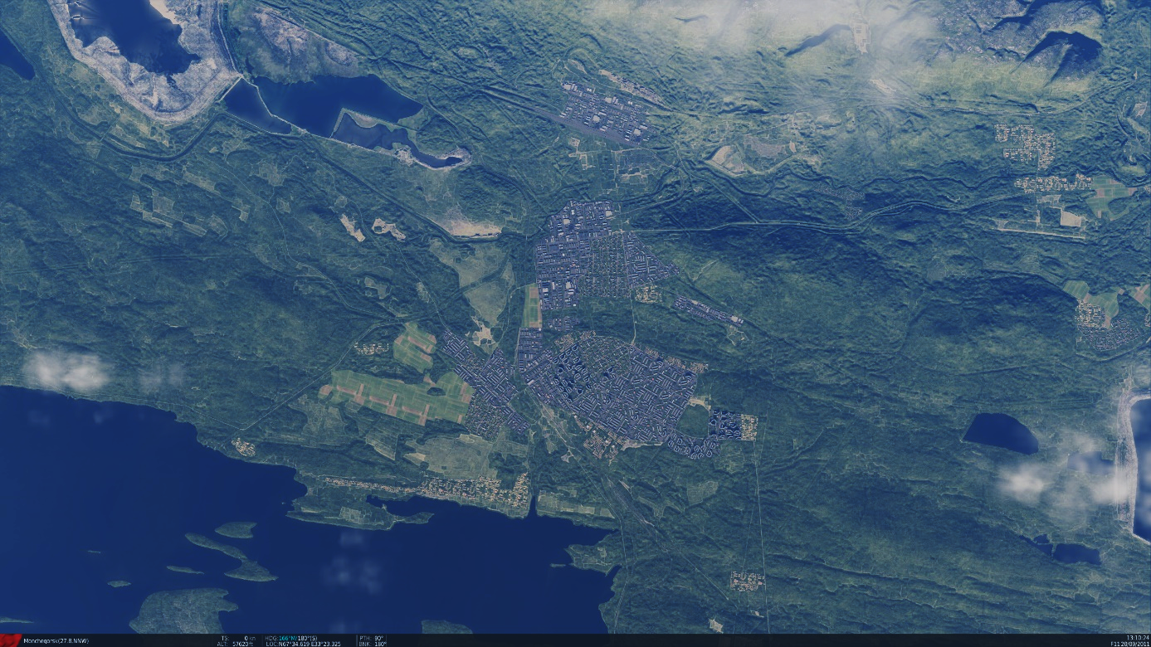
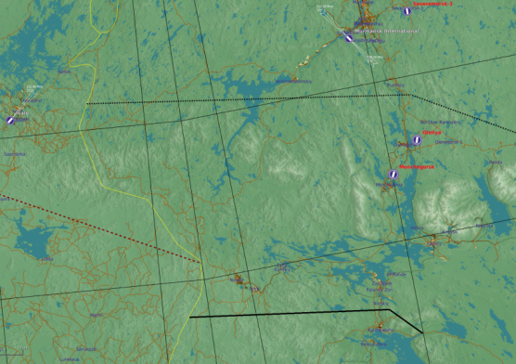


SRNTGT072 Apatite SAM Factory
SRNTGT072
N
N 67 34.982 E 033 23.048 – 500ft
Apatite SAM Factory
DESCRIPTION OF THE DESIRED POINTS OF IMPACT
N 67 34.944 E 033 22.964 – 500ft,SRNTGT072 -A: Production facility
N 67 34.924 E 033 22.955 – 500ft,SRNTGT072 -B: Production facility
N 67 34.964 E 033 23.102 – 500ft,SRNTGT072 -C: Power to production facility
N 67 34.963 E 033 23.136 – 500ft,SRNTGT072 -D: Backup power
N 67 34.991 E 033 23.115 – 500ft,SRNTGT072 -E: Fuel

Slide 2
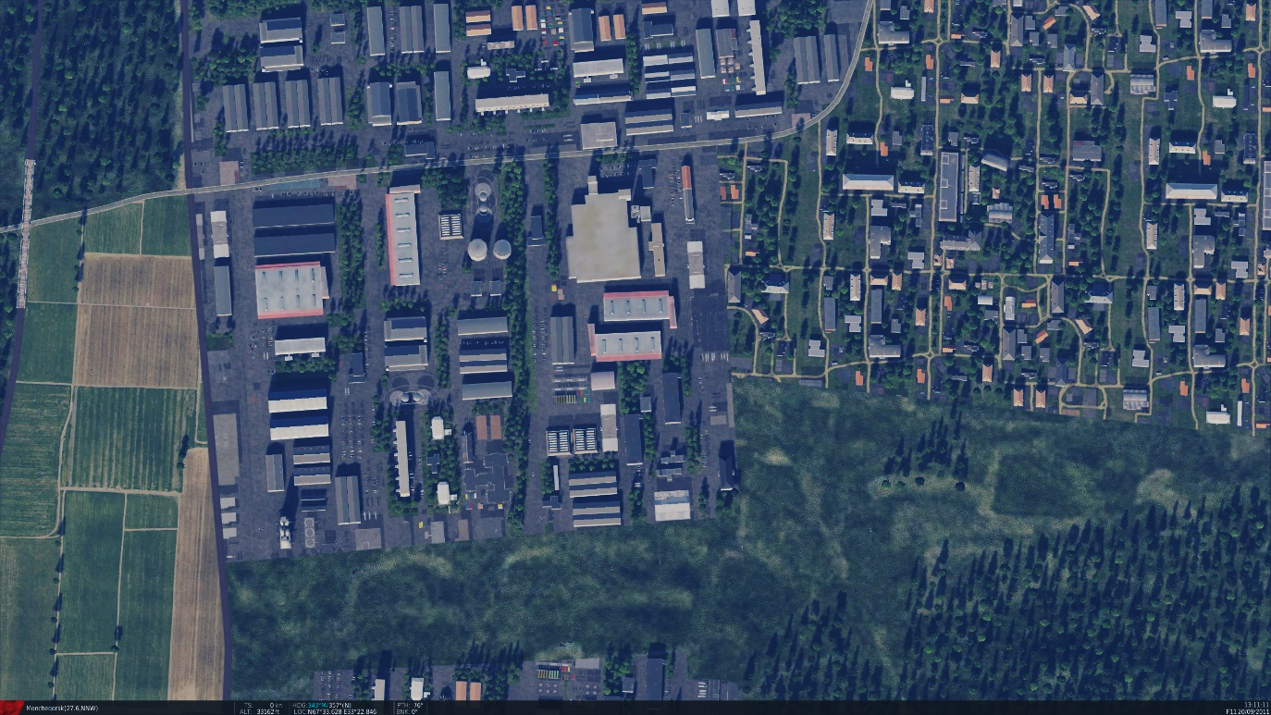
SRNTGT072 Apatite SAM Factory
WARNING
SRNTGT072 and SRNTGT073 in close proximity!
N
SRNTGT072
SRNTGT073
DESCRIPTION OF THE DESIRED POINTS OF IMPACT
N 67 34.944 E 033 22.964 – 500ft,SRNTGT072 -A: Production facility
N 67 34.924 E 033 22.955 – 500ft,SRNTGT072 -B: Production facility
N 67 34.964 E 033 23.102 – 500ft,SRNTGT072 -C: Power to production facility
N 67 34.963 E 033 23.136 – 500ft,SRNTGT072 -D: Backup power
N 67 34.991 E 033 23.115 – 500ft,SRNTGT072 -E: Fuel

Slide 3
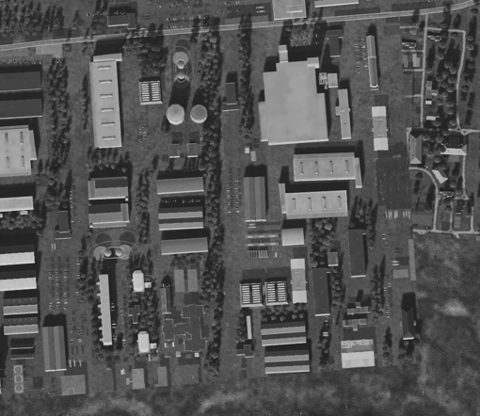
SRNTGT072 Apatite SAM Factory
Weapon type needed SRNTGT072
SRNTGT072 -A: Production facility – 4x500 lbs. With 25ms fuze OR 1x 2,000lbs 10ms needed
SRNTGT072 -B: Production facility – 4x500 lbs. With 25ms fuze OR 1x 2,000lbs 10ms needed
SRNTGT072 -C: Power to production facility
Concrete building. At least 1x1,000 lbs weapon needed for effect or 1x2,000lbs
SRNTGT072 -D: Backup power
Concrete building. At least 1x1,000 lbs weapon needed for effect or 1x2,000lbs
SRNTGT072 -E: Fuel
1x2,000 lbs weapon needed, 25ms fuze
SRNTGT072A
SRNTGT072E
N
SRNTGT072D
SRNTGT072B
SRNTGT072C
DESCRIPTION OF THE DESIRED POINTS OF IMPACT
N 67 34.944 E 033 22.964 – 500ft,SRNTGT072 -A: Production facility
N 67 34.924 E 033 22.955 – 500ft,SRNTGT072 -B: Production facility
N 67 34.964 E 033 23.102 – 500ft,SRNTGT072 -C: Power to production facility
N 67 34.963 E 033 23.136 – 500ft,SRNTGT072 -D: Backup power
N 67 34.991 E 033 23.115 – 500ft,SRNTGT072 -E: Fuel

